Slide 1
Email Spam Detection Using Machine Learning Algorithms
G. AKHIL - 22J41A1220
P. VIVEK - 22J41A1250
K. SIVA KRISHNA - 22J41A1224
V. NIKITHA - 22J41A1263
UNDER THE GUIDANCE OF
Mr. P. Vinay Kumar
DATE: 01-05-2025

Slide 2
INTRODUCTION
Every day, millions of spam emails are sent across the globe, causing a range of problems
for individuals and organizations alike.
Spammers take advantage of the ease with which fake email accounts and online profiles
can be created, disguising themselves as trustworthy sources.
In response to this challenge, our project aims to develop a robust spam email detection
system using machine learning techniques.
The system will analyze the content and
metadata of emails to differentiate between spam and harm messages.
The Random Forest algorithm outperformed the others in terms of overall accuracy
and consistency.

Slide 3
PROBLEM STATEMENT
Email Spam has become a major problem nowadays, with Rapid growth of internet users, Email spams is also increasing.
People use these for illegal activities like phishing and fraud.
It's easy for spammers to create fake profiles and email accounts, pretending to be trustworthy.
Develop a system to classify emails as “spam” or "ham" using machine learning ,that focus on text-based email content analysis and evaluate ML algorithms like Random Forest and Naive Bayes.
Ensuring high accuracy and efficiency in spam detection.

Slide 4
LITERATURE REVIEW
Almeida, Gómez, & Yamakami, A. (2010):
This study focuses on SMS spam filtering but provides insights into feature selection and classification algorithms applicable to email spam detection using machine learning.
Carreras, & Marquez, L. (2001):
The authors propose a boosting-based approach for email spam filtering. The study discusses the use of decision trees as weak learners in the boosting algorithm.
Platt, J. C. (1999):
This paper discusses the use of support vector machines (SVM) for email spam filtering. It focuses on the optimization techniques to speed up the training process of SVM models.
Rani, & Nasa, R. (2021):
This study performs a comparative analysis of machine learning algorithms for spam email detection. It evaluates the performance of algorithms such as Naive Bayes, decision trees, and K-nearest neighbours.

Slide 5
EXISTING PROJECT:
Tokenization is the process of breaking a manuscript into smaller meaningful units, called tokens, which can be words, phrases, symbols, or other expressive elements.
Tokenization plays a crucial role in both linguistics, where it aids in text segmentation, and computer science, where it facilitates lexical analysis.
Alphabetic characters grouped together form a single token, and the same applies to numbers.
Additionally, other projects were created using different machine learning methods, such as the KNN algorithm and decision trees.
The primary disadvantage of these systems, was their inability to achieve efficiency and accuracy.

Slide 6
PROPOSED SOLUTION:
Data Preprocessing is done, it includes two main tasks Data Cleaning and Data Merging. Data Cleaning includes tasks such as removal of outliers, null value removal, removal of unwanted features from data and in Data merging, the datasets are merged to form a single dataset containing only two features(text, label).
Our project detects Spam by using Random Forest Algorithm and Random Forest Genetic Algorithm.
Then it is performed on various Datasets, from those dataset combinations are made.
Instead of identifying a single potential path it visits each node and verifies that each path leads to the required result.
High efficiency and accuracy were observed.

Slide 7
DESIGN & METHODOLOGY
.Tools Used :
Language: Python.
Libraries: TensorFlow, NumPy, Pandas, Scikit-learn.
Hardware: i3 processor, 4GB RAM, 40GB HDD.
OS: Windows 8 or above.
TensorFlow : TensorFlow is a free and open-source software library for dataflow and differentiable programming across range of tasks.
NumPy : NumPy is a general-purpose array-processing package. It provides a high-performance multidimensional array object, and tools for working with these arrays.
Pandas : Pandas is an open-source Python Library providing high-performance data manipulation and analysis tool using its powerful data structures.
Scikit-learn : Scikit-learn provides a range of supervised and unsupervised learning algorithms via a consistent interface in Python.

Slide 8
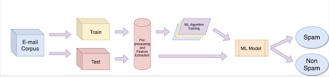
Flow Chart:

Slide 9
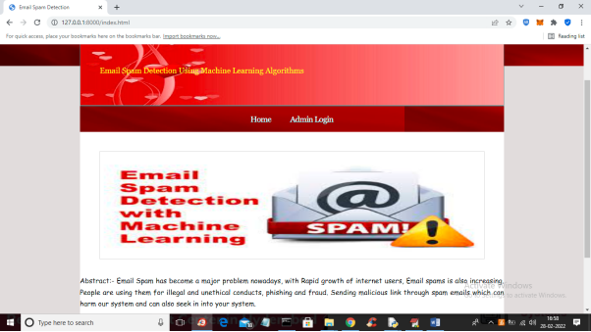
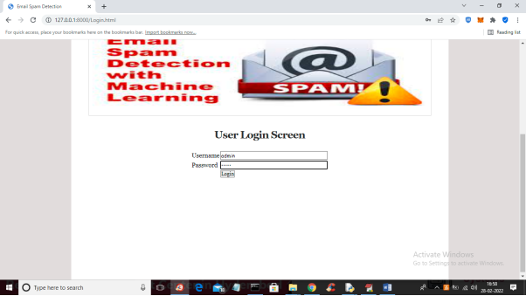
IMPLEMENTATION
Admin Module:

Slide 10
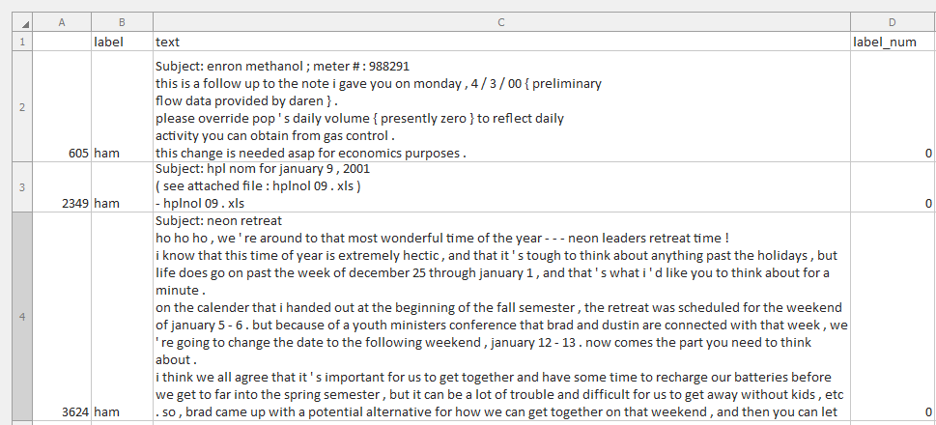
Data Set:

Slide 11
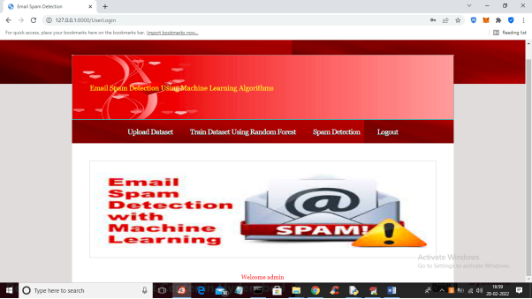
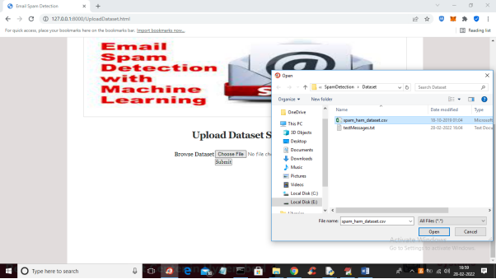
RESULT

Slide 12
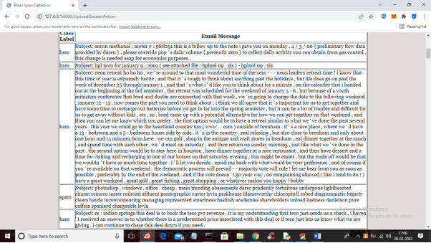
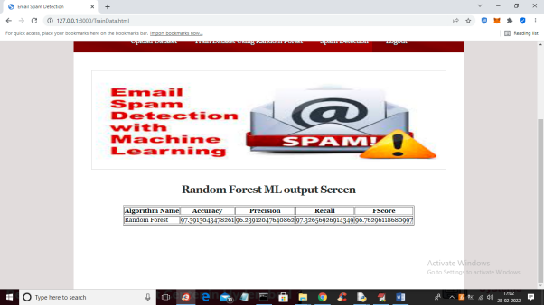

Slide 13
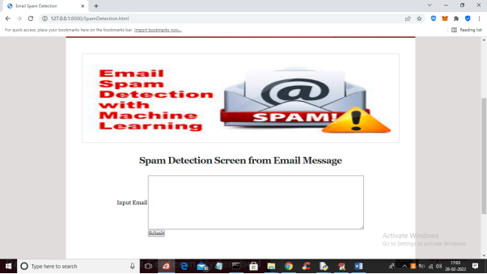
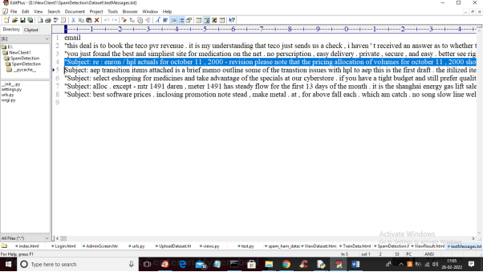

Slide 14
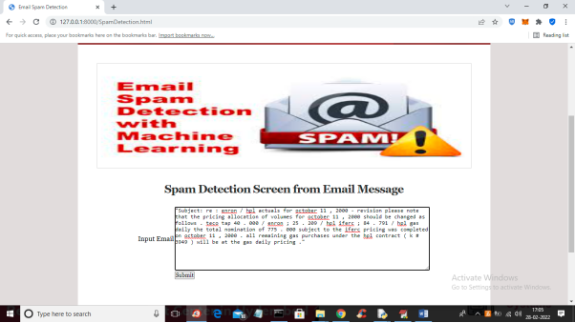
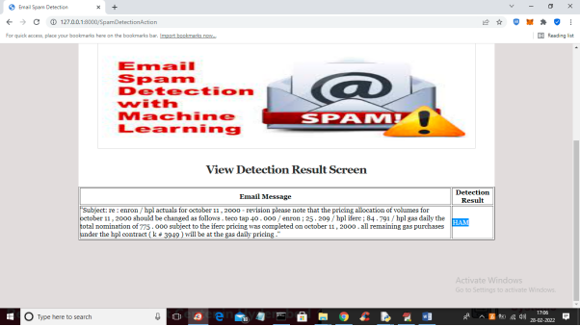

Slide 15
FUTURE WORK
We can construct a hybrid model which combines Random Forest with deep learning models like CNN(Convolutional Neural Network) for more robust and context-aware classification.
Future versions can directly block or delete emails classified as spam by integrating the model with email clients using SMTP(Simple Mail Transfer Protocol) protocols.

Slide 16
.
.
CONCLUSION
Achieved 97% accuracy, surpassing traditional methods.
System is scalable with potential for advanced features.
Today, a huge number of emails are exchanged, but our project can only test a small set
due to limited data.
Our project, thus spam detection is proficient of filtering mails giving to the content of
the email and not according to the domain names or any other criteria.

Slide 17
REFERENCE
Suryawanshi, et al. (2019). Email Spam Detection: Comparative Study of ML and Ensemble Classifiers. IEEE .
Karim, A., et al. (2019). A Comprehensive Survey for Intelligent Spam Email Detection. IEEE Access.
Awad, & ELseuofi, S.M. (2011). Machine Learning Methods for Spam E-Mail Classification.
Python Official Website: https://www.python.org
https://sist.sathyabama.ac.in - Where we made reference to the ongoing project.

Slide 18
THANK YOU

